Slide 1
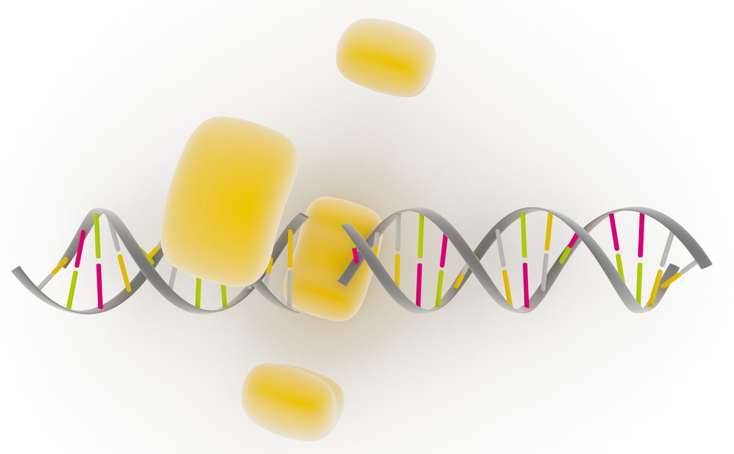
Nibrin &
Nijmegen breakage syndrome
Nicole Libert
April 23, 2015

Slide 2
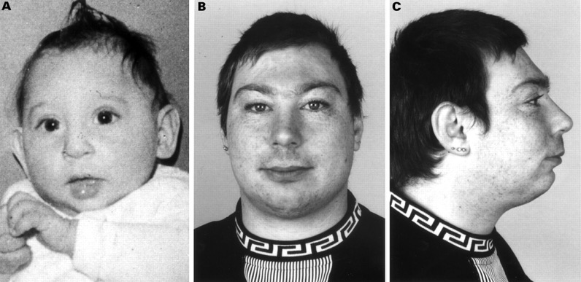
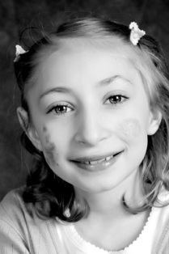
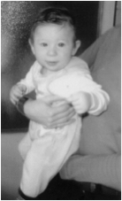
What is Nijmegen breakage syndrome (NBS)?
Abnormal physical features
Intellectual disability
Immunodeficiency
Premature ovarian failure
Cancer predisposition

Slide 3
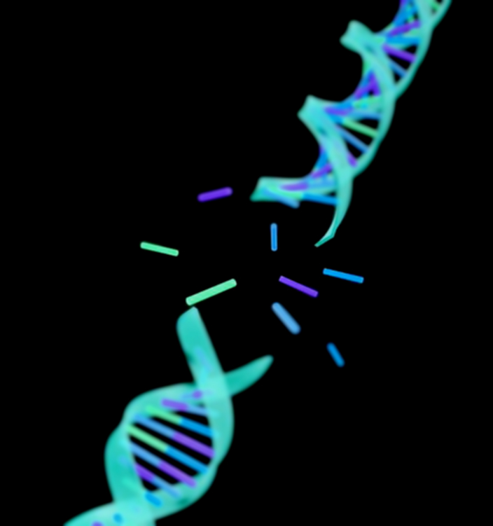
What is affected by NBS?
Chromosomes
Telomeres
Cell cycle checkpoints
Sensitivity to DNA-damaging agents

Slide 4
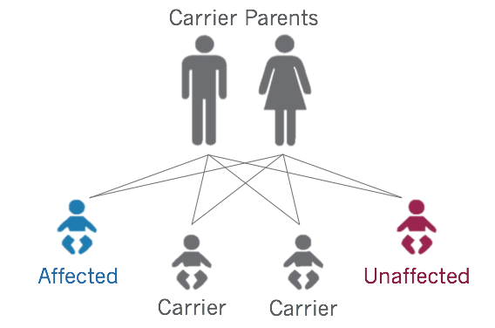
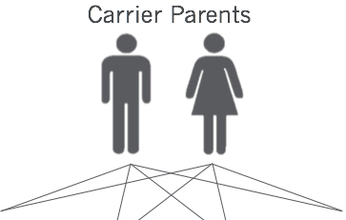
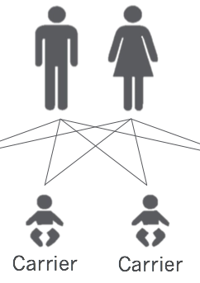
How is NBS inherited?
1 in 100,000
1 in 177

Slide 5
Nibrin is associated with NBS
(NBN)
FHA
BRCT
BRCT
Nbs1_C

Slide 6
What mutations are found in Nibrin?
657del5
NBN
p95- nibrin
FHA
BRCT
BRCT
Nbs1_C
(Wild type)
FHA
BRCT
p26-nibrin
p70-nibrin
BRCT
Nbs1_C

Slide 7
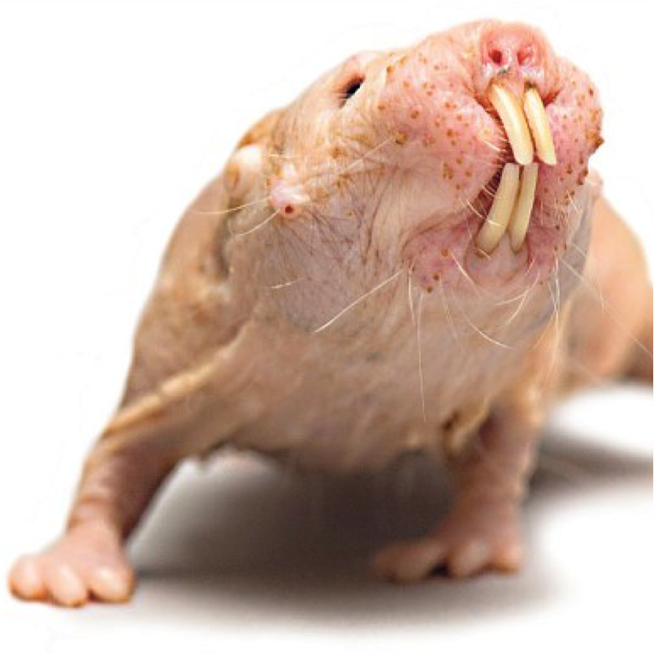
What is Nibrin phylogeny?
Elephant
Fruit Fly
Zebrafish
Coelacanth
Cave Fish
Platypus
Frog
Zebra Finch
Duck
Chicken
Turkey
Mouse
Rat
Armadillo
Dog
Cat
Cow
Dolphin
Macaque
Gorilla
Human
Naked Mole
Rat
Chimp
Horse
Rabbit

Slide 8
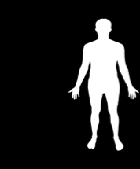
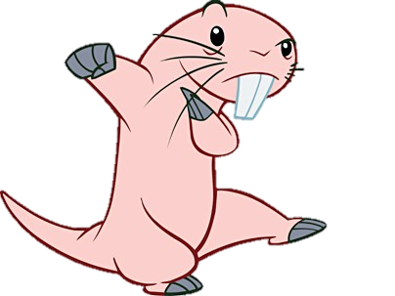
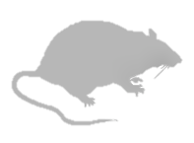
Is Nibrin conserved?
754aa
754aa
98%
80%
742aa
751aa
71%
70%
750aa
818aa
44%
37%
818aa
FHA BRCT Nbs1_C
Notes:
Note the conservation across domains
-fruit flies don’t have Nbs1_c but are known to possess binding domain to Mre11

Slide 9
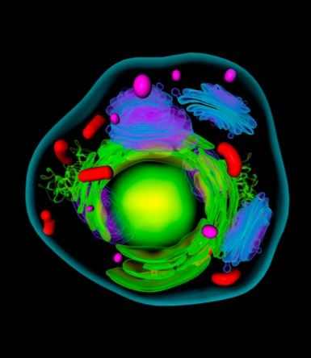
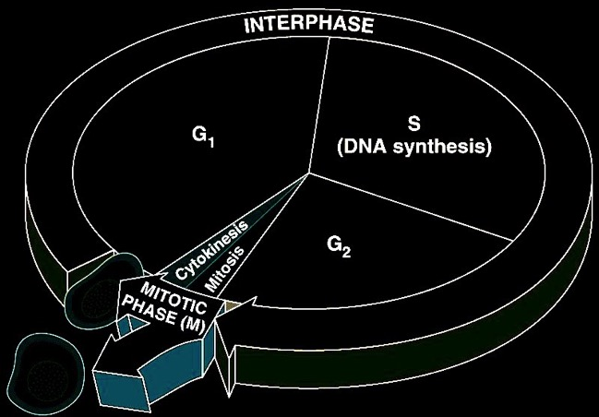
What does Nibrin do?
Rad50
NBN
Mre11
Cellular
Components
Molecular
Functions
Biological
Processes
Protein binding
FHA
BRCT
Nbs1_C

Slide 10
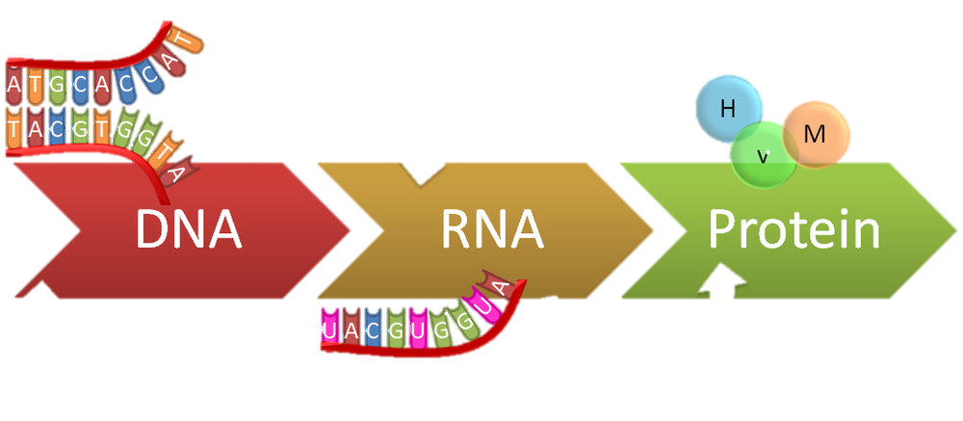
Gap in knowledge
Transcription
What are the molecular mechanisms that regulate NBN expression?

Slide 11
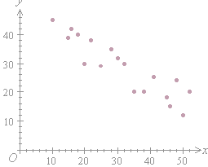
Hypothesis
As expression of NBN
Cancer predisposition
Cancer predisposition
Expression of NBN
Individual

Slide 12
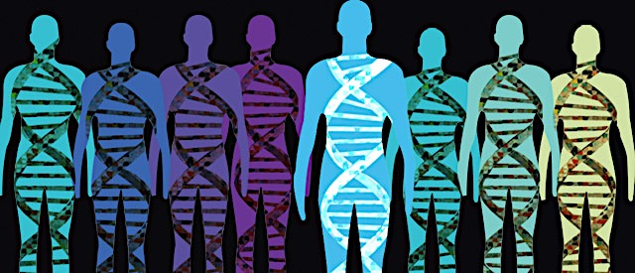
Aim 1:
Identify SNPs directly affecting nibrin expression levels.
Hypothesis & Approach:
}
Next generation sequencing
Correlation?
Nibrin expression
Quantitative Mass Spectrometry
Notes:
Lower levels will have cancer
Include cancer

Slide 13
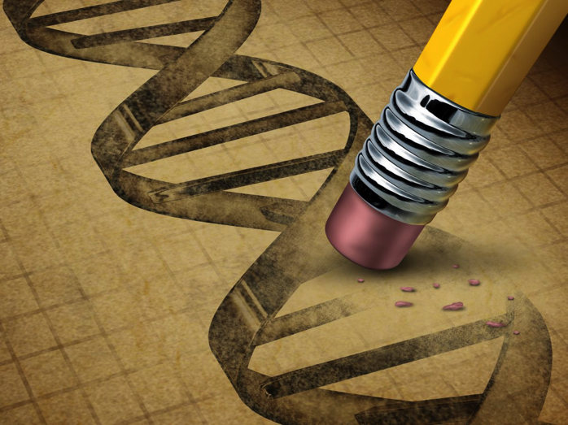
Aim 1:
Identify SNPs directly affecting nibrin expression levels.
Rationale:
Nibrin
Expression
Cancer
Predisposition
SNP Manipulation

Slide 14
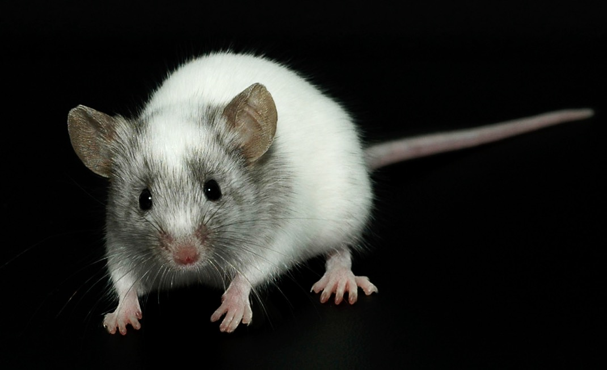
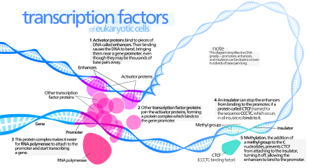
Aim 2:
Identify transcription factors (TF) that regulate nibrin expression.
Hypothesis & Approach:
High
Wild Type
Influenced
TF Mutant
CRISPR-based screen
& CRISPR-Cas9
CRISPR-Cas9
Knockout

Slide 15
Aim 2:
Identify transcription factors (TF) that regulate nibrin expression.
Rationale:
Nibrin
Expression
Cancer
Predisposition
TF Manipulation

Slide 16
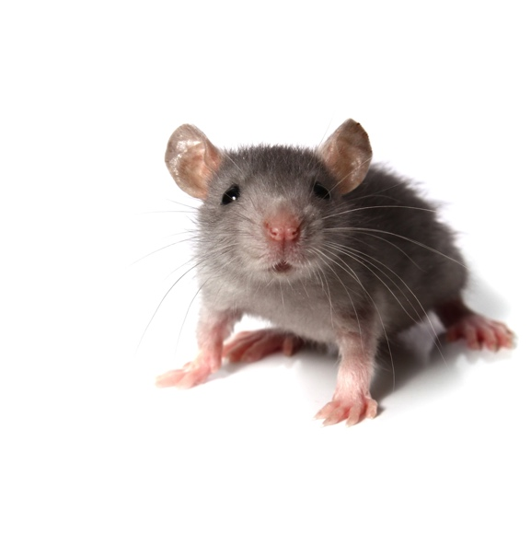
Aim 3:
Determine nibrin expression levels in naked mole-rats.
Hypothesis & Approach:
Wild type
TF Mutant
(using Aim 2)
Knockout
Nibrin expression
Quantitative mass
spectrometry
(control)
Notes:
Transcription factors will regulate levels

Slide 17
Aim 3:
Determine nibrin expression levels in naked mole-rats.
Rationale:
Nibrin
Expression
Cancer
Predisposition

Slide 18
Future Directions
Long-term goal: Help those affected by NBS
Overall goal: Help the population by screening for Nibrin-related cancer.
Notes:
Add overall goal about helping the population screen for NBN related cancer

Slide 19
References
Pictures by slides
1: https://dl5db4br4ix6p.cloudfront.net/articles/21/images/1024.jpg?1380898480
2:http://adc.bmj.com/content/82/5/400/F1.large.jpg
http://joyrx.org/heroKids/Yana_large.jpg
http://learn.genetics.utah.edu/content/chromosomes/telomeres/images/brokendna.jpg
3: http://www.testmygenes.info/files/2014/04/EPECS_Affected-Unaffected-01-1024x737.jpg
4. http://ghr.nlm.nih.gov/gene/NBN
5. Clustal omega
6. Smart & Pfam
7: https://prontoprofr.files.wordpress.com/2010/10/animal-cell-cellula-animale.jpg?w=150&h=128
8. String Database
9. http://www.zo.utexas.edu/faculty/sjasper/images/12.4.gif
http://www.nature.com/nsmb/journal/v16/n8/full/nsmb0809-798.html
http://www.pharmaceutical-journal.com/Pictures/580xAny/0/6/2/1068062_human-chromosome-telomere-15.jpg
10. http://www.ojrd.com/content/7/1/13
11 & 12. http://images.rapgenius.com/82b71adf0d8d1d8997ee95debc1fb8b5.1000x437x1.png
14. http://www.totalhealth.co.uk/sites/www.totalhealth.co.uk/files/personal%20medicine.jpg
15. http://fc09.deviantart.net/fs8/i/2005/363/c/9/Naked_Mole_Rat_by_justicetoall.jpg
https://s3.amazonaws.com/go-public/image/go-logo.large.png
16. http://www.animalresearch.info/files/2014/1865/5563/mouse_white_black_background_2charwell.jpg
http://profile.cich.ca/images/uploads/magnifying_glass_and_gene_strand.jpg
http://www.vibconferences.be/sites/default/files/styles/conference_intro_image/public/event-images/%5Bnid%5D/picture_copy_0.jpg?itok=OR7cyJPF
17. https://www.colourbox.com/preview/2644615-bottle-with-white-pills-on-black-background.jpg

